Slide 1
Event Analysis: SFLARE_bn110803292
[9.9487889e-01 3.0607625e-04 6.3481892e-04 4.1802195e-03]

Slide 2
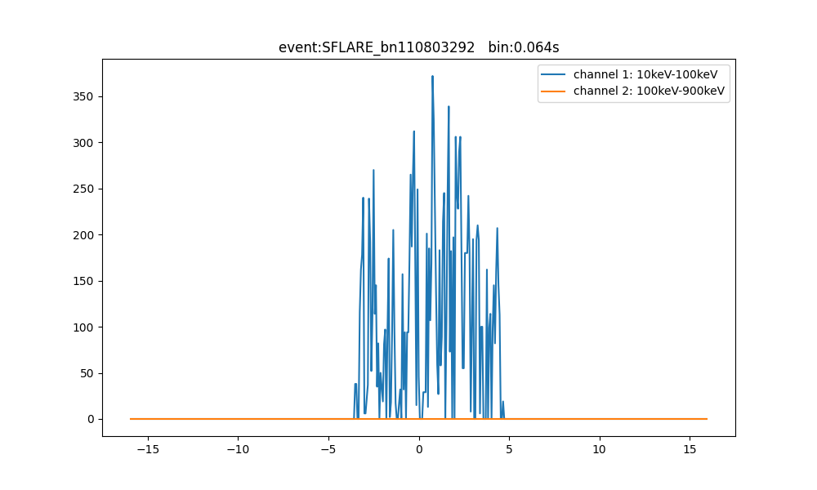

Slide 3
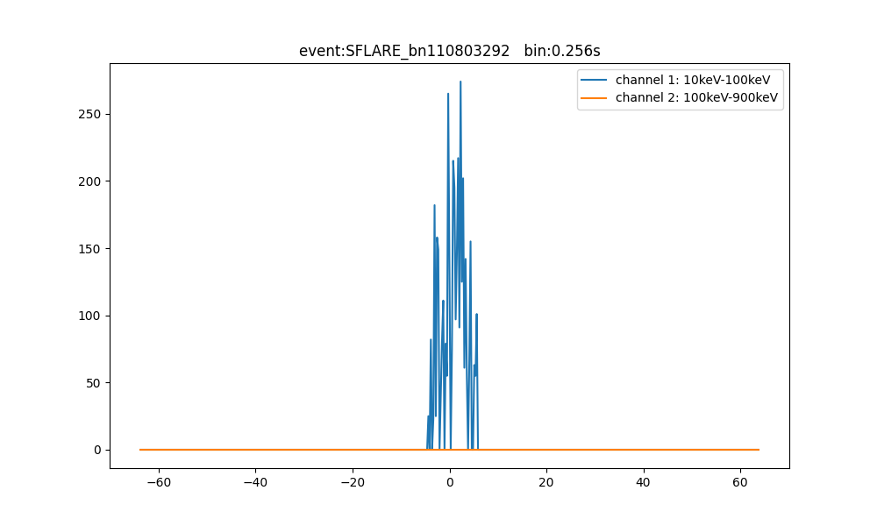

Slide 4
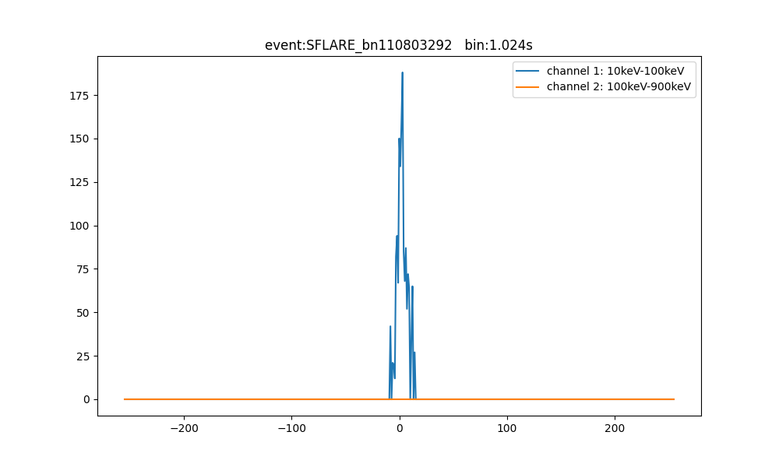

Slide 5
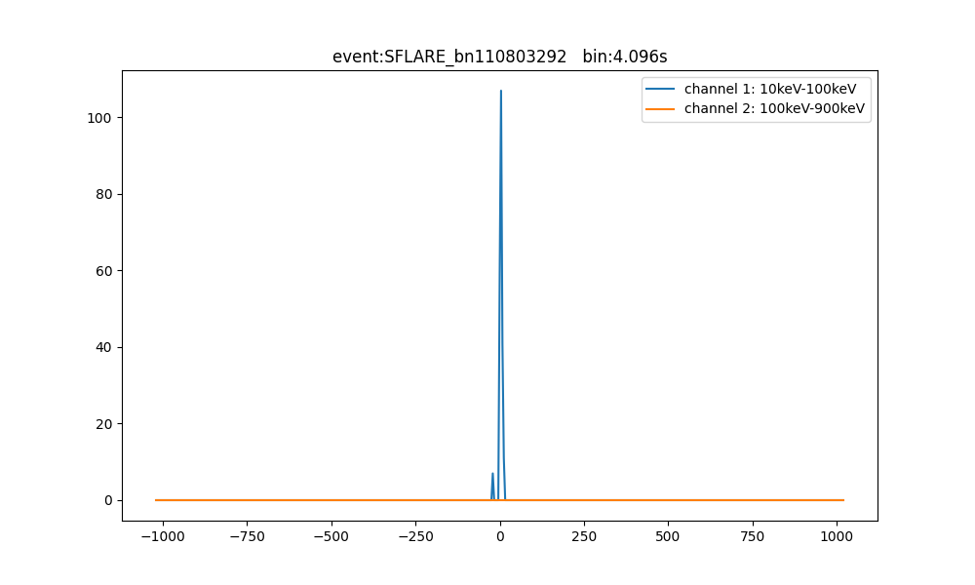

Slide 6
Event Analysis: SFLARE_bn140203655
[0.8439026 0.02281222 0.00966184 0.12362336]

Slide 7
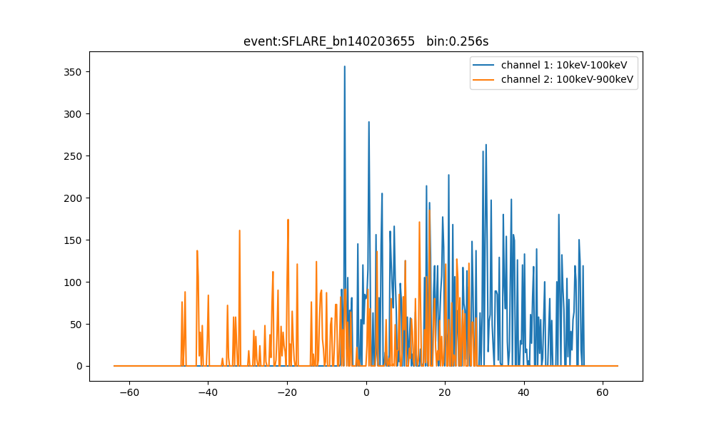

Slide 8
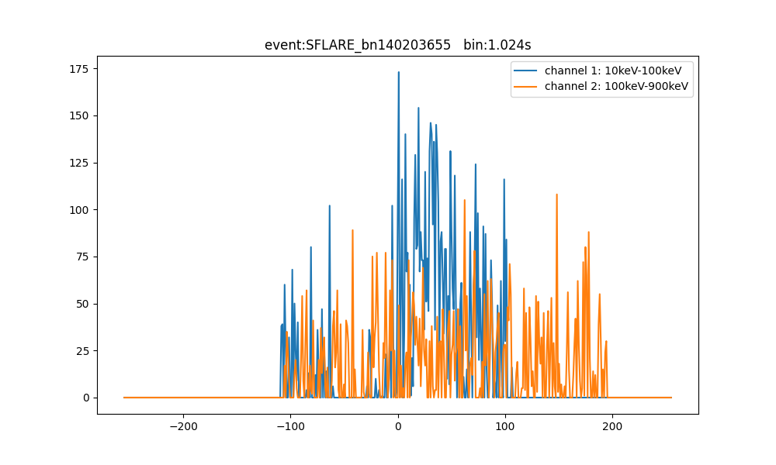

Slide 9
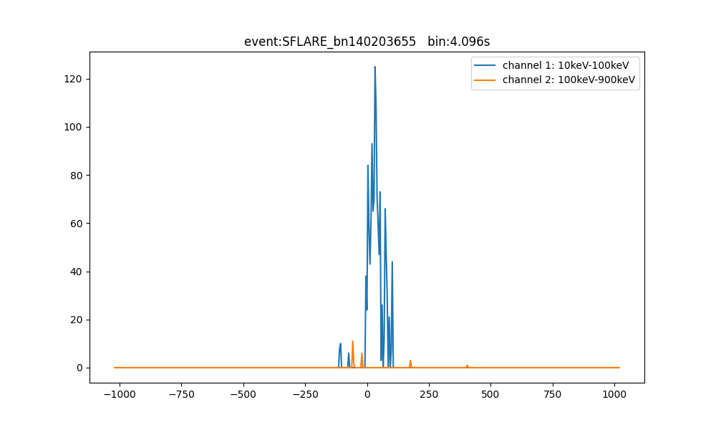

Slide 10
Event Analysis: SFLARE_bn140208432
[0.7740942 0.0056215 0.03046047 0.18982385]

Slide 11
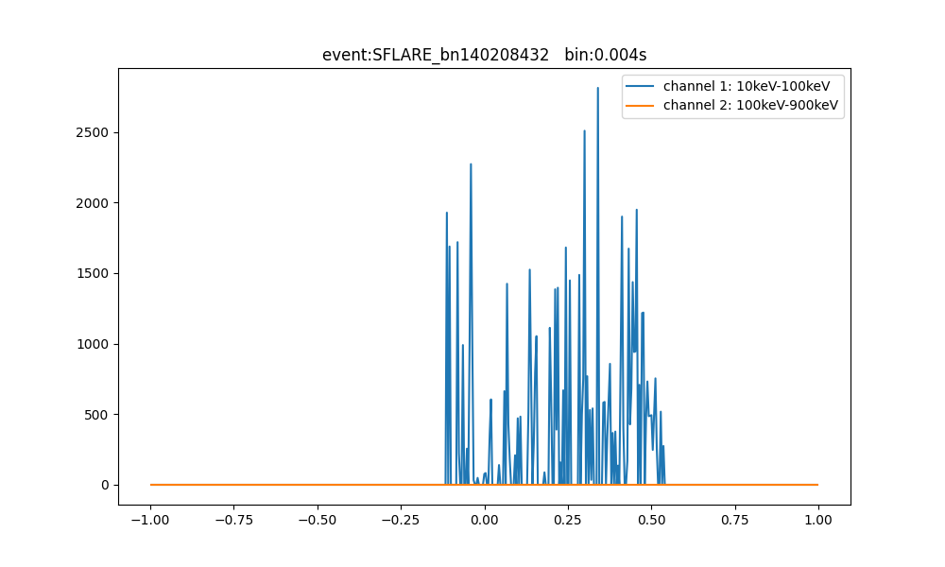

Slide 12
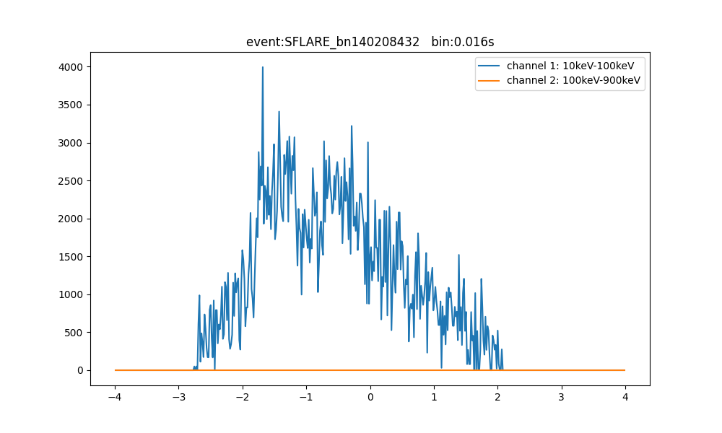

Slide 13
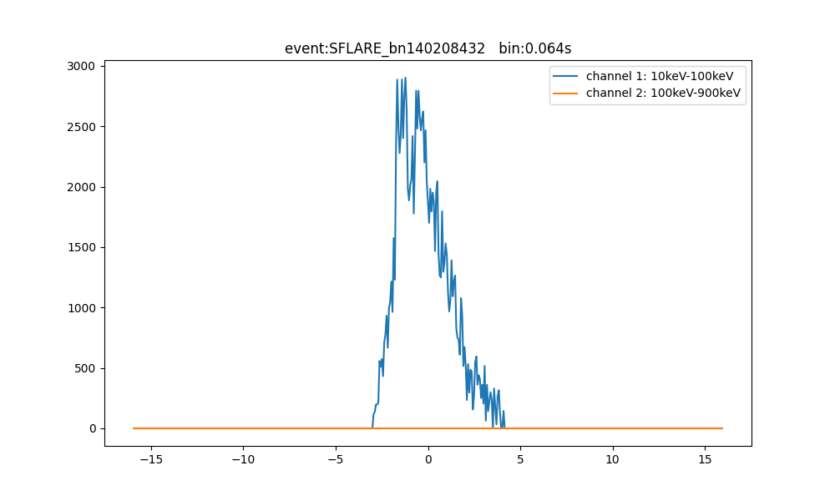

Slide 14
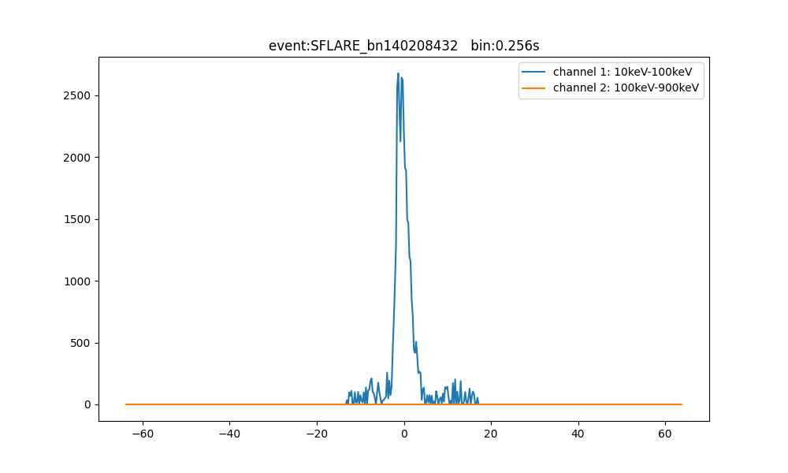

Slide 15
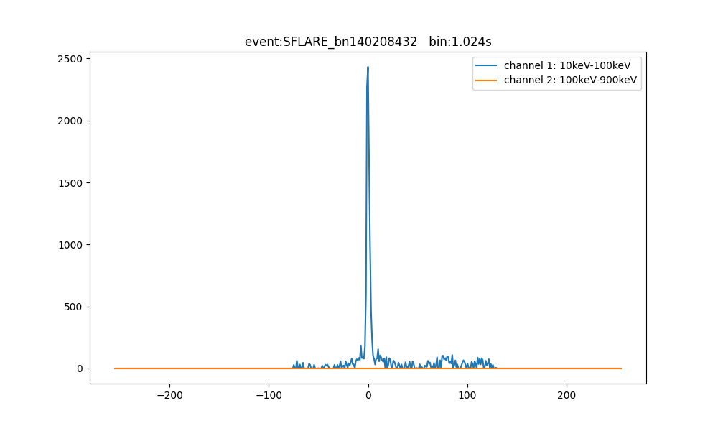

Slide 16


Slide 17
Event Analysis: SFLARE_bn141029951
[0.8933415 0.00175585 0.00381273 0.10108992]

Slide 18
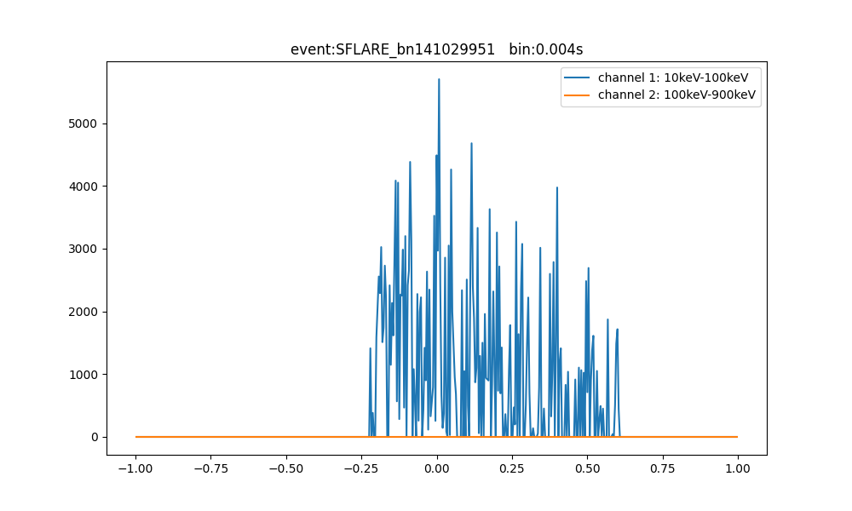

Slide 19
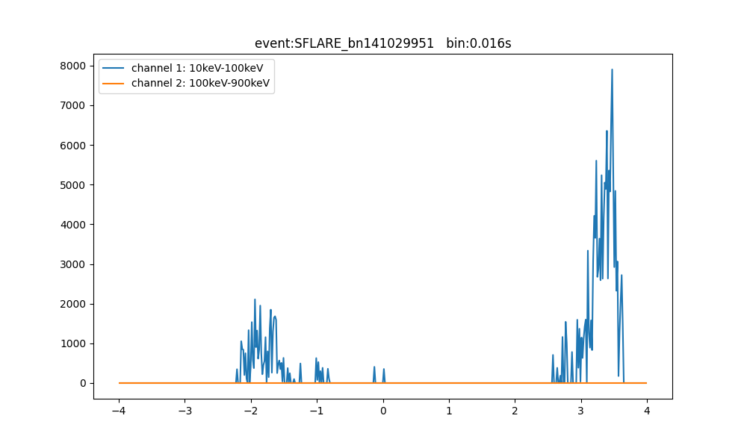

Slide 20
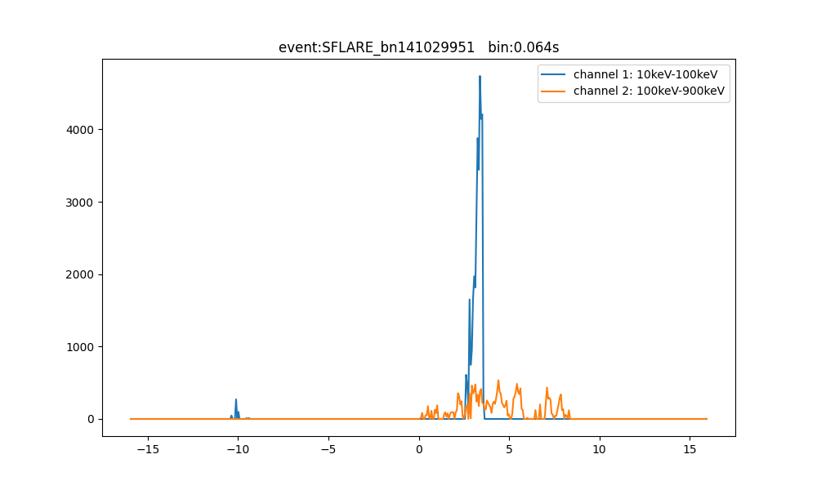

Slide 21
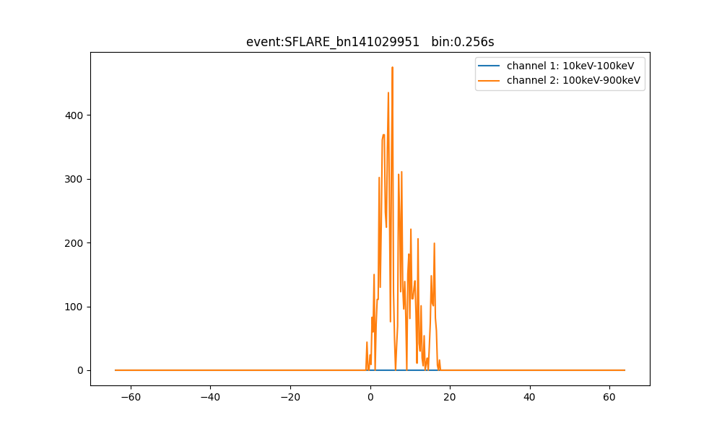

Slide 22
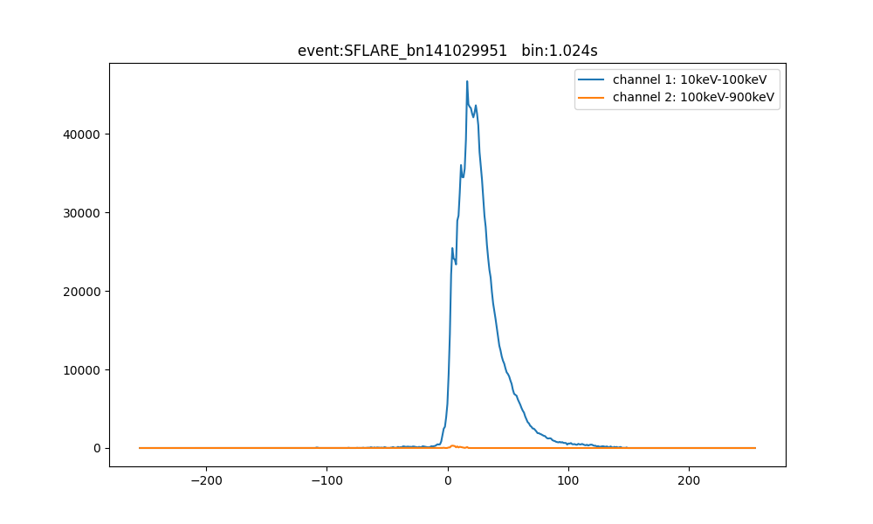

Slide 23
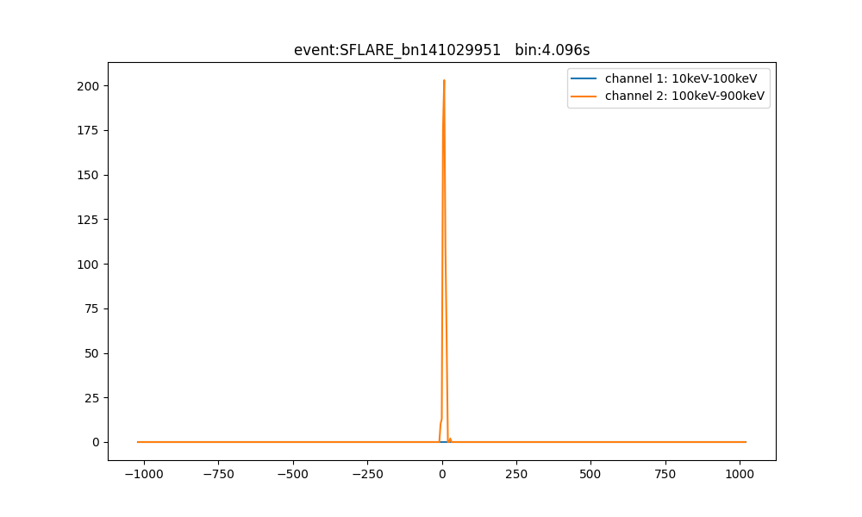

Slide 24
Event Analysis: SFLARE_bn150102825
[0.83409935 0.0025726 0.00354076 0.1597873 ]

Slide 25
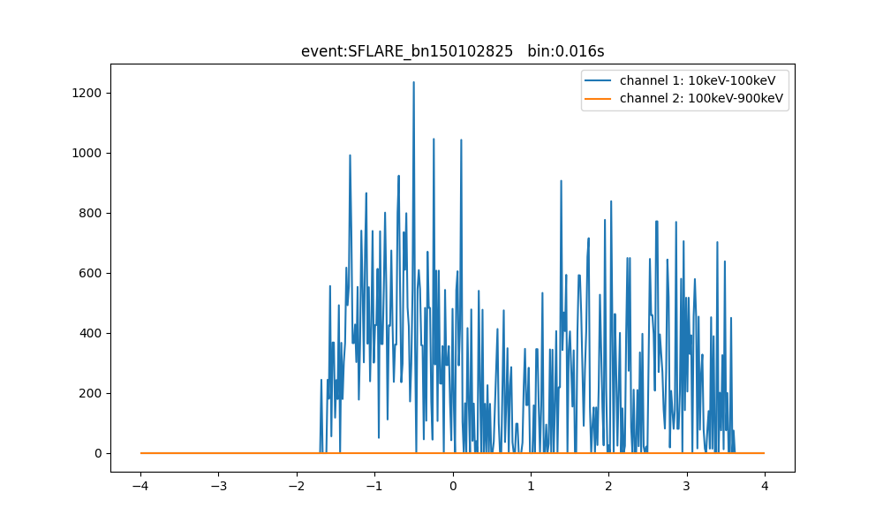

Slide 26
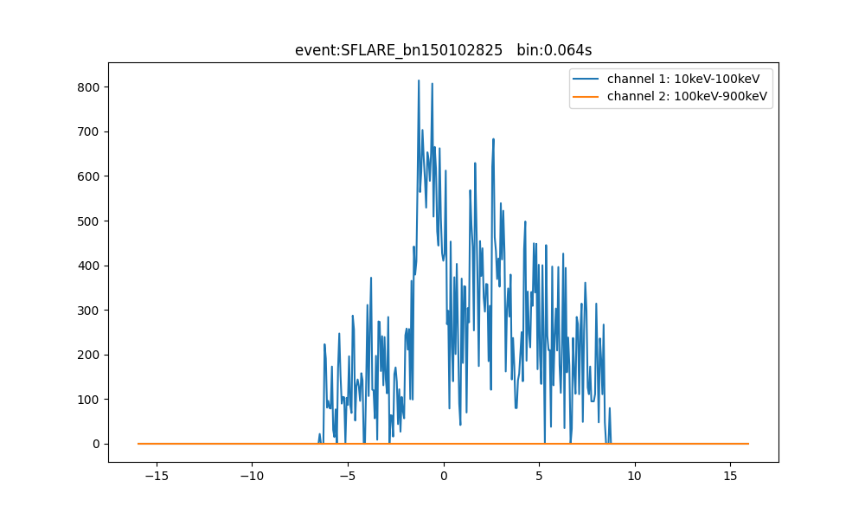

Slide 27
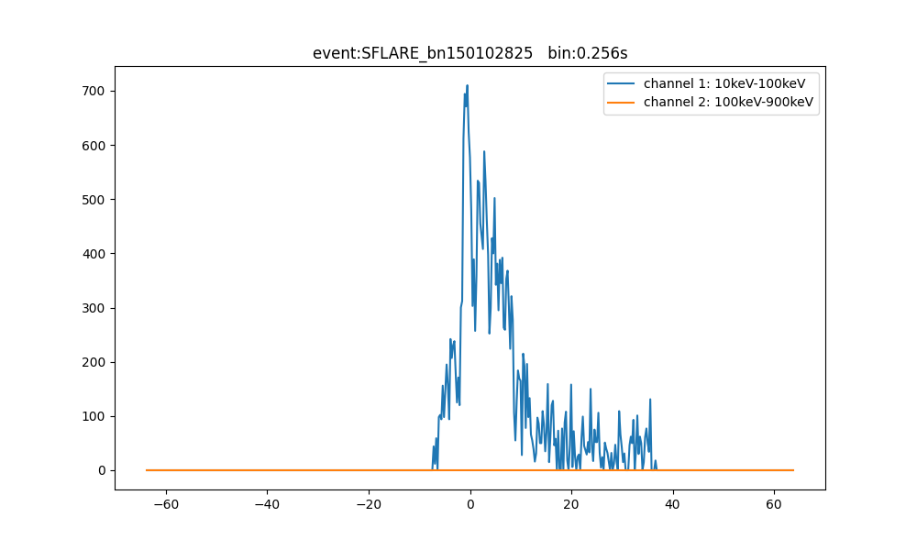

Slide 28
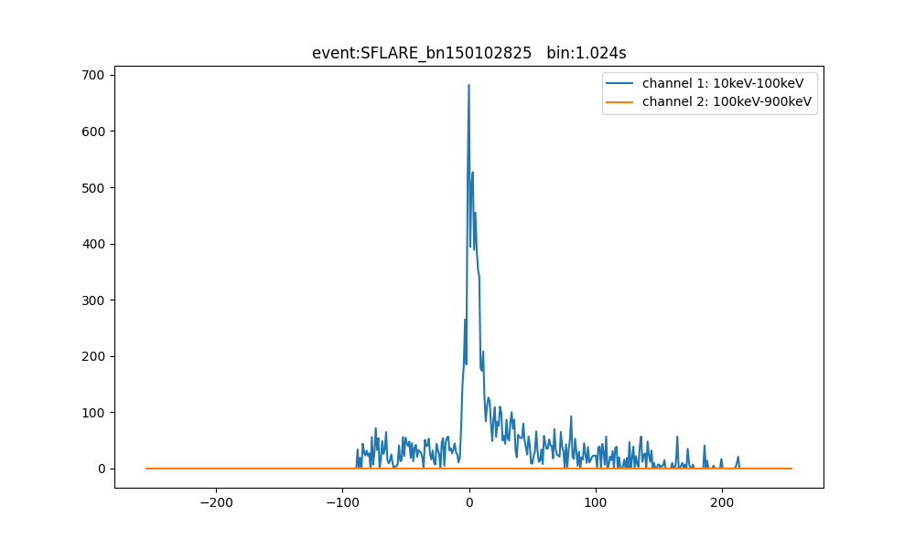

Slide 29
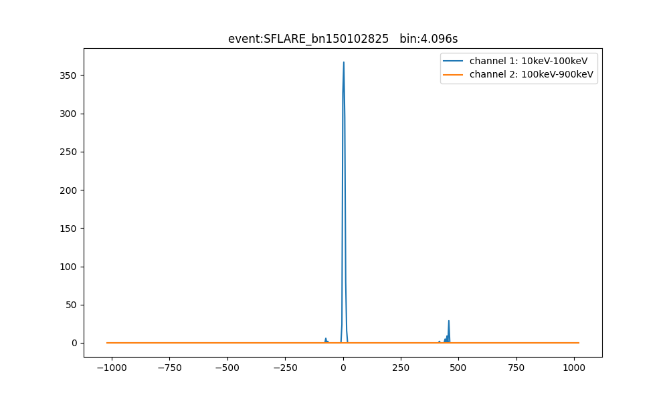

Slide 30
Event Analysis: SFLARE_bn150826485
[0.9729874 0.00100882 0.00152688 0.02447688]

Slide 31
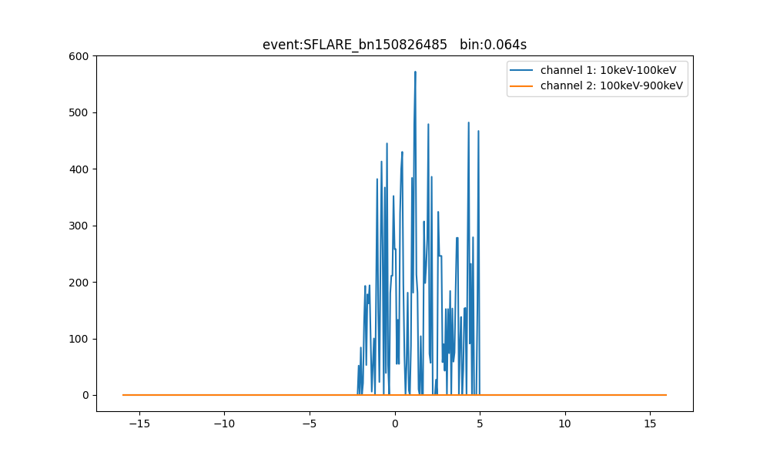

Slide 32
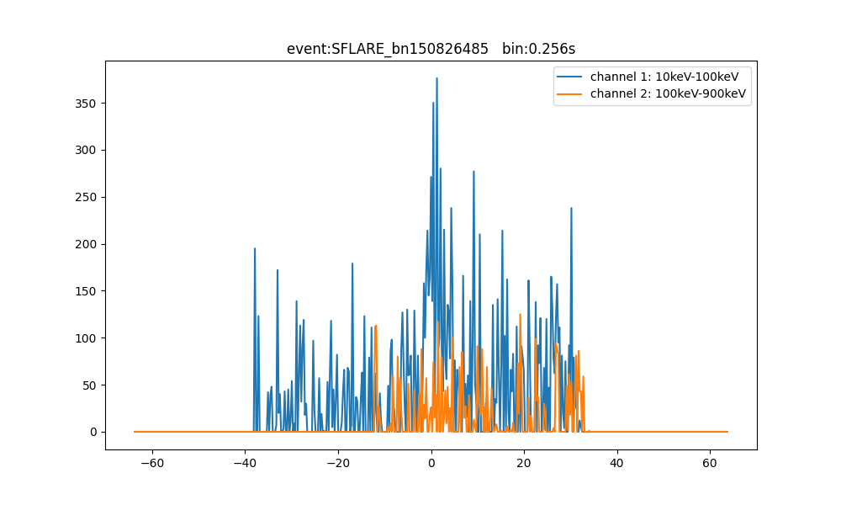

Slide 33
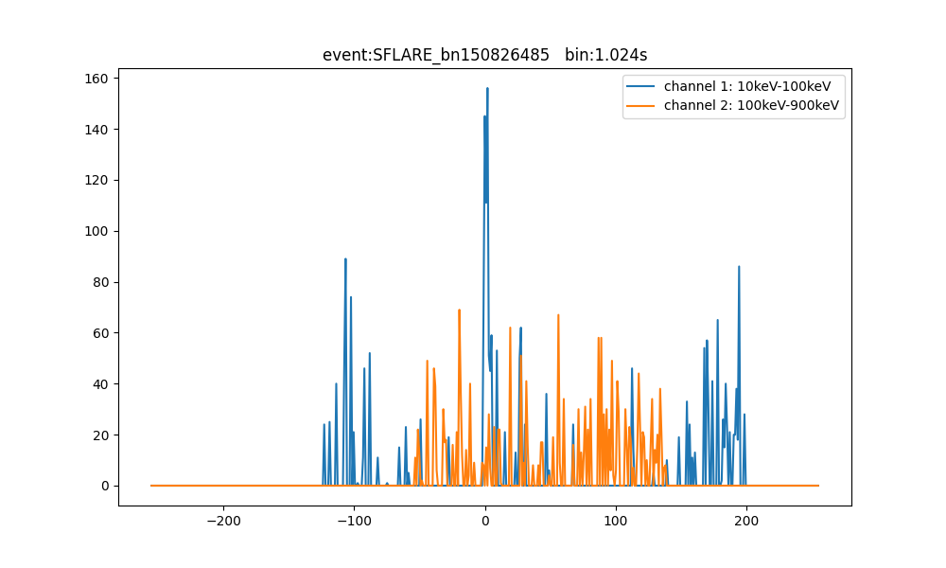

Slide 34
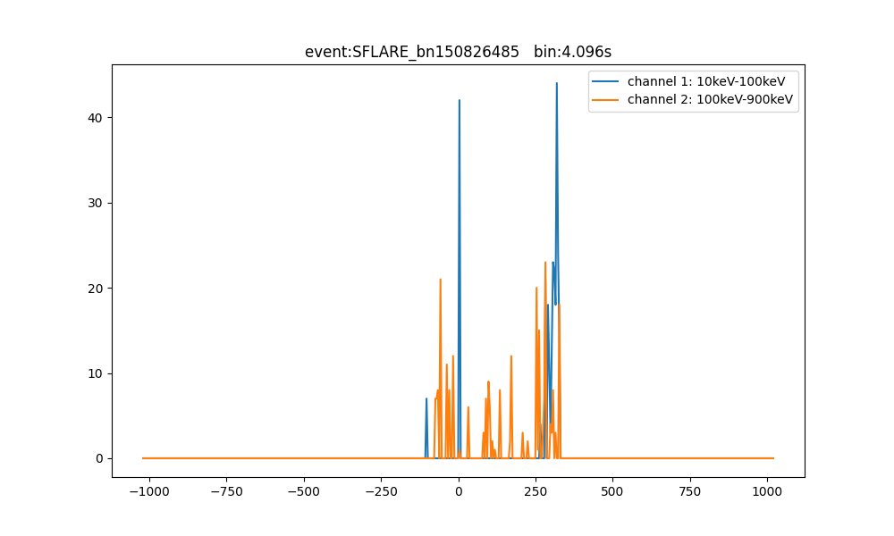

Slide 35
Event Analysis: SFLARE_bn211101986
[0.8538437 0.01789533 0.00753896 0.12072193]

Slide 36
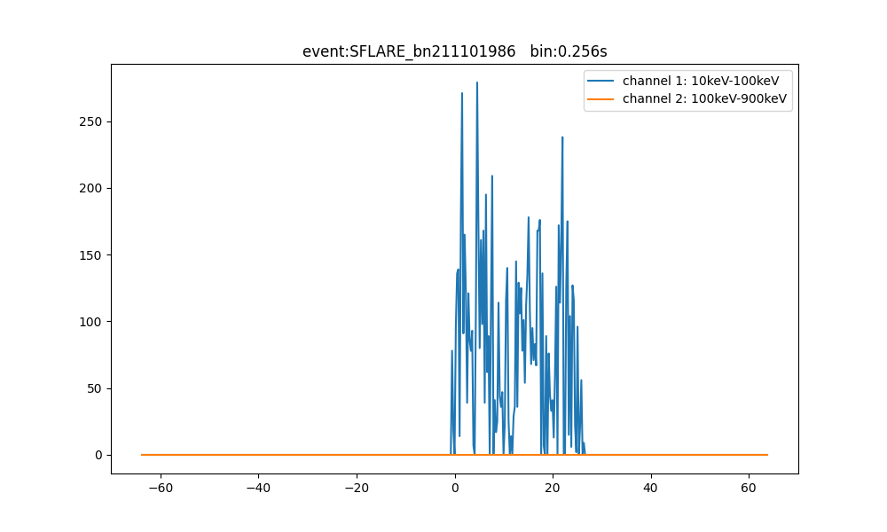

Slide 37
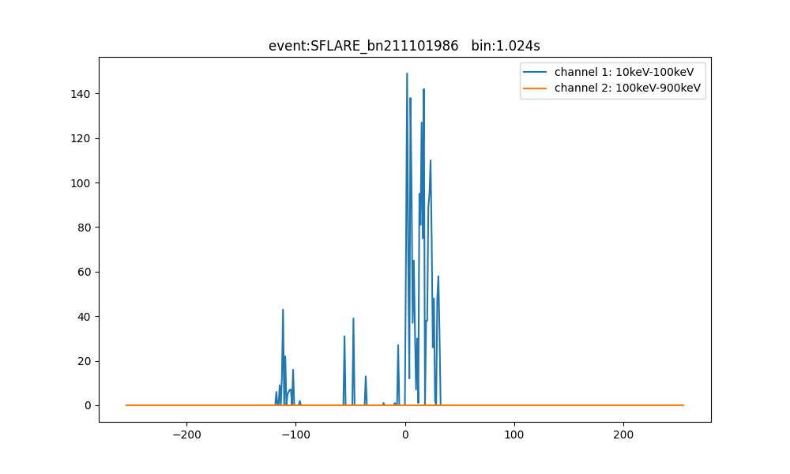

Slide 38
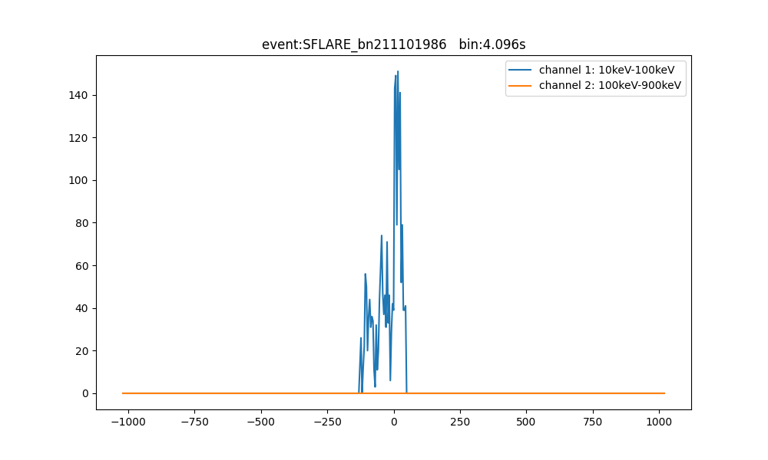

Slide 39
Event Analysis: SFLARE_bn220508817
[9.7258329e-01 7.0517225e-04 1.0907092e-03 2.5620891e-02]

Slide 40
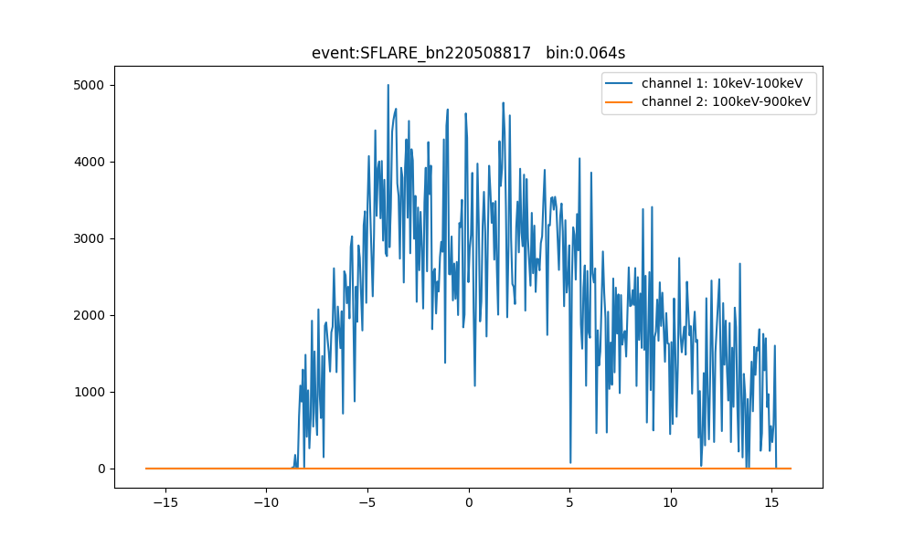

Slide 41
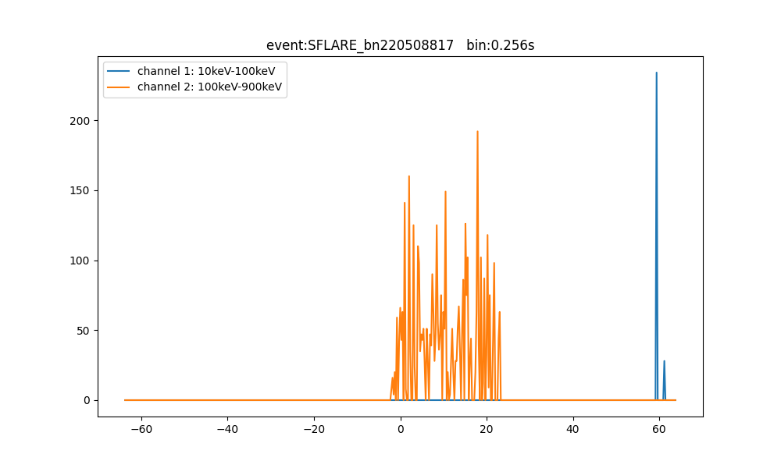

Slide 42
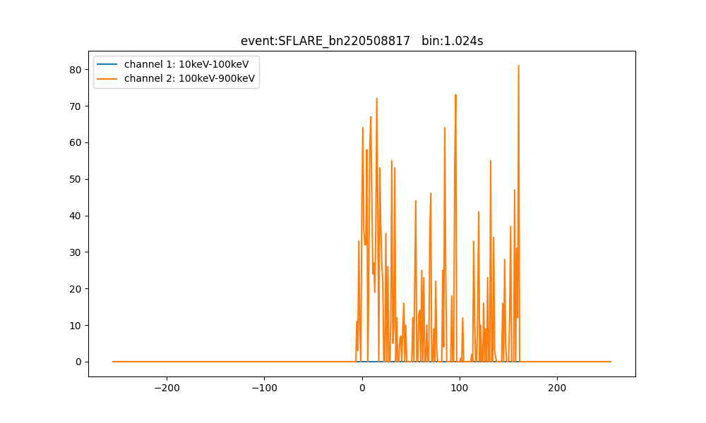

Slide 43
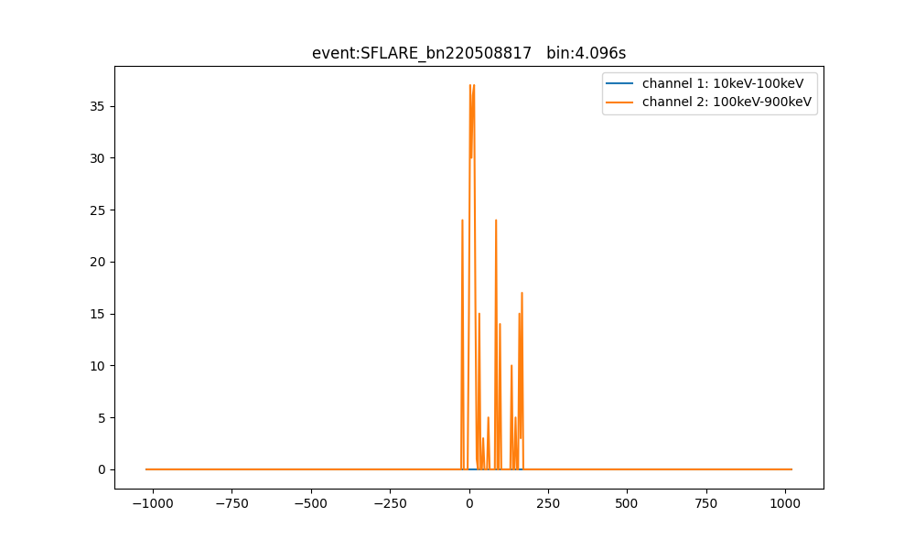

Slide 44
Event Analysis: SFLARE_bn230929134
[0.9371819 0.02011133 0.00640111 0.0363057 ]

Slide 45
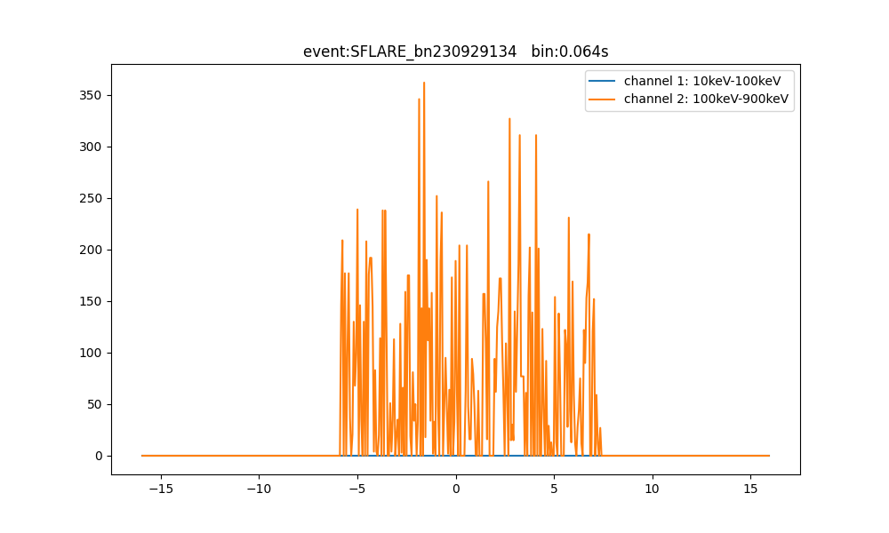

Slide 46
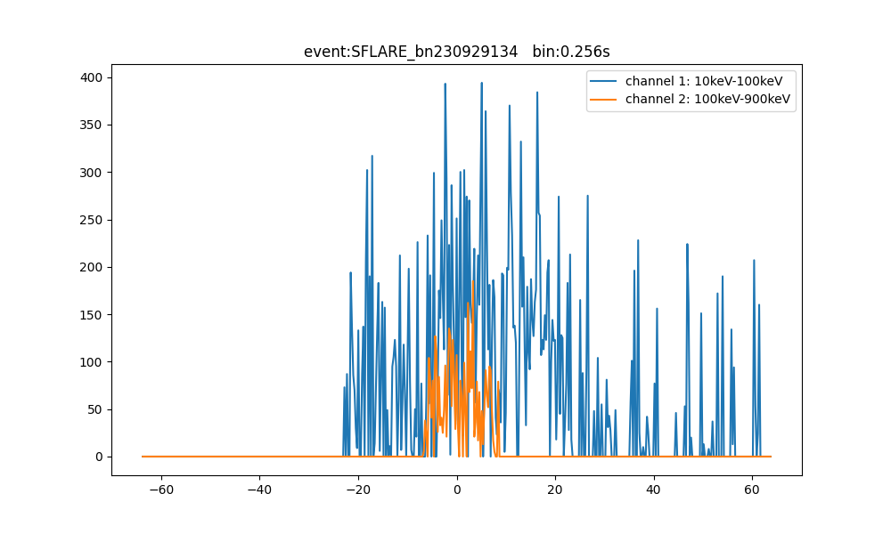

Slide 47
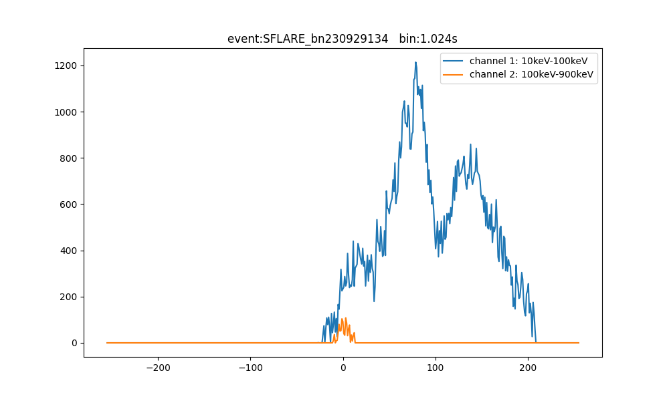

Slide 48
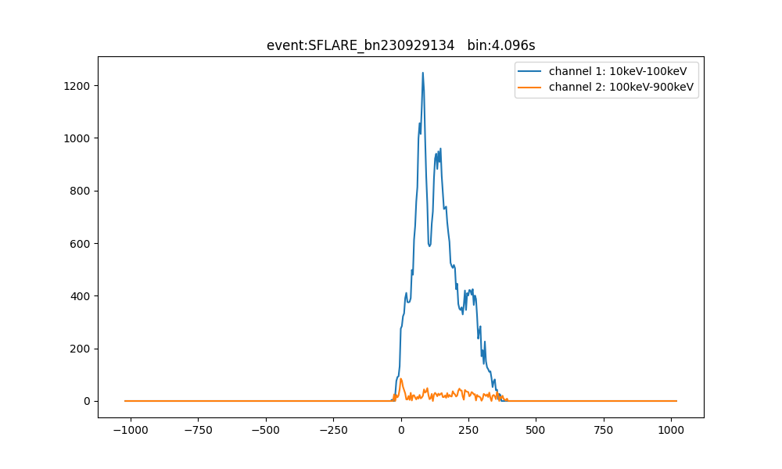

Slide 49
Event Analysis: SFLARE_bn240123749
[0.94181854 0.00167943 0.00220329 0.05429879]

Slide 50
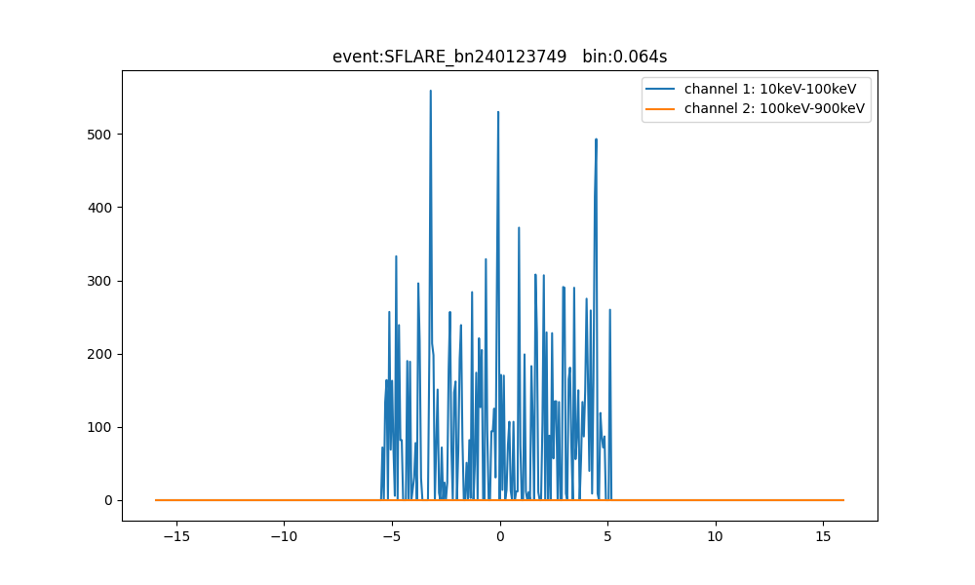

Slide 51
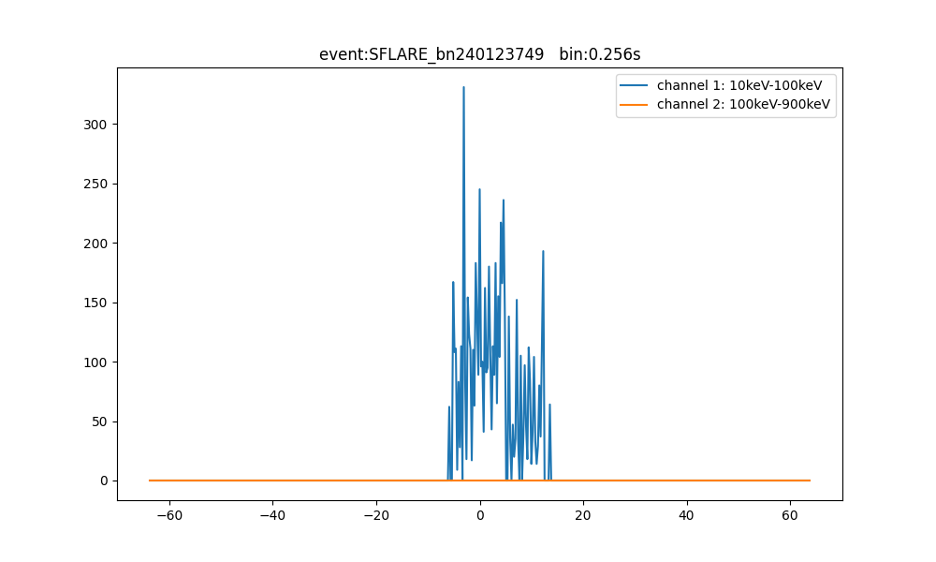

Slide 52
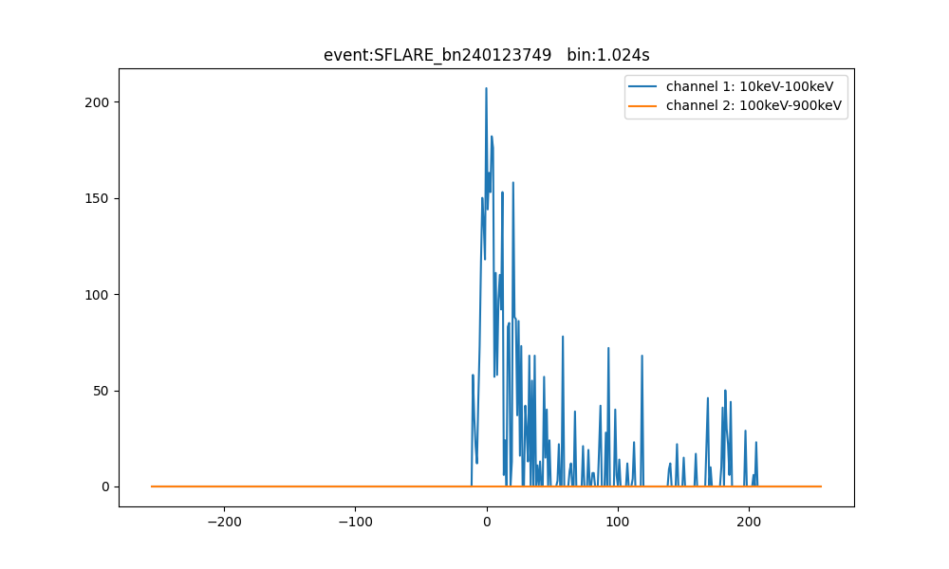

Slide 53
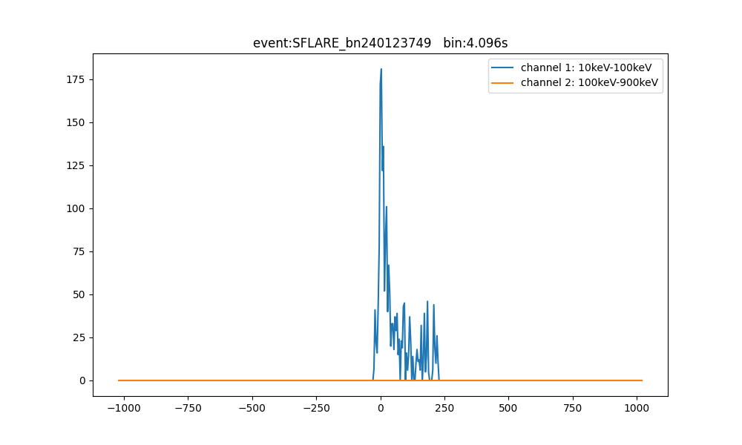

Slide 54
Event Analysis: GRB_bn100224112
[0.2666811 0.01170874 0.00605939 0.7155508 ]

Slide 55
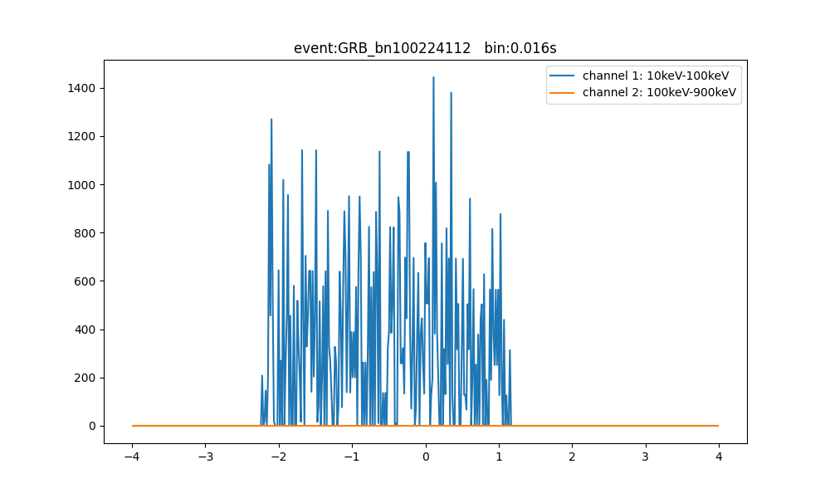

Slide 56
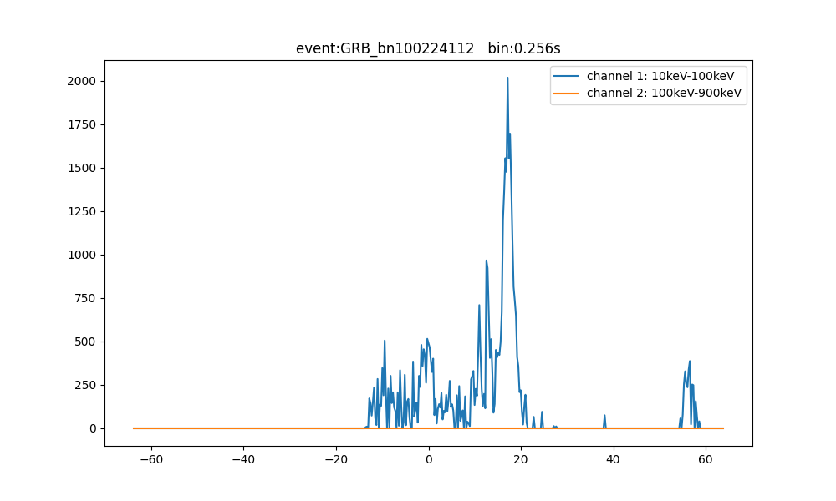

Slide 57
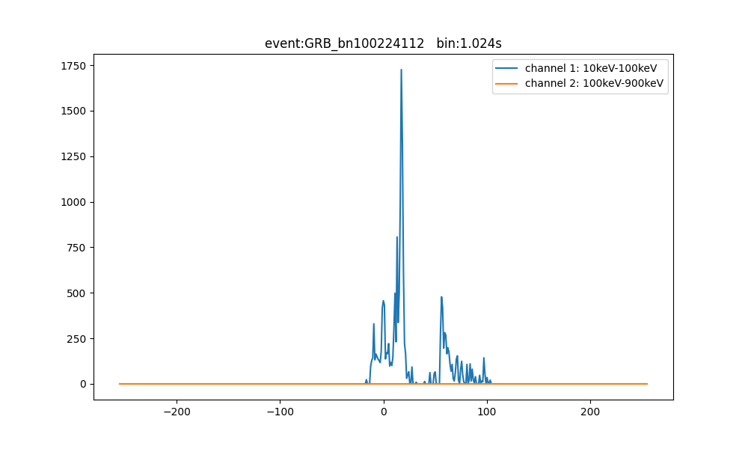

Slide 58
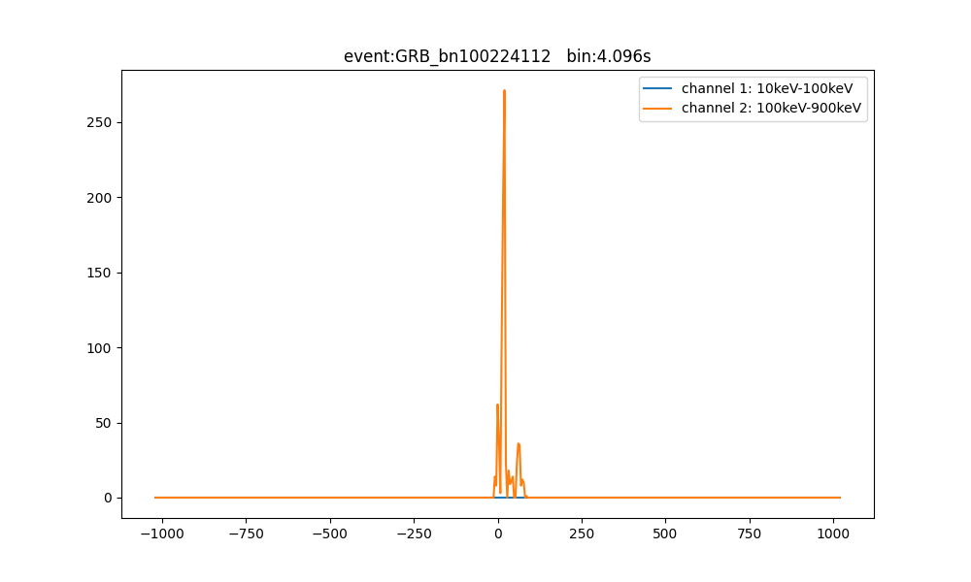

Slide 59
Event Analysis: GRB_bn100926595
[0.02551233 0.00144729 0.00130547 0.9717349 ]

Slide 60
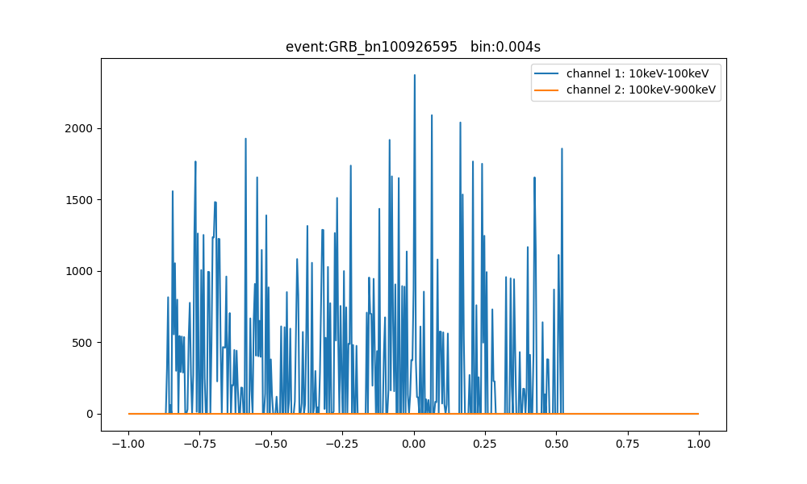

Slide 61
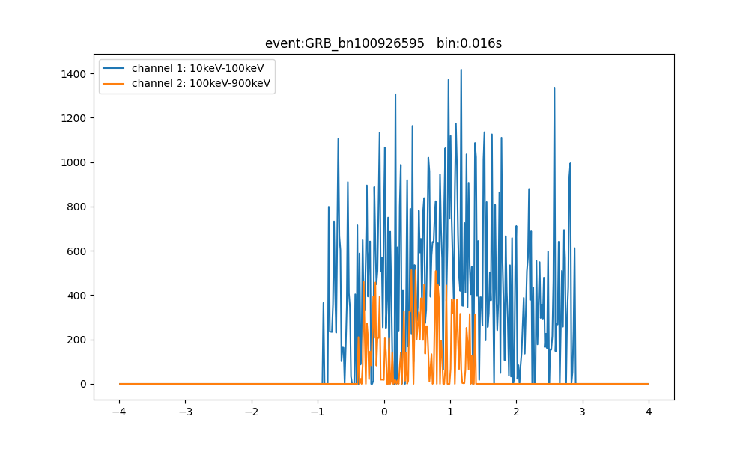

Slide 62
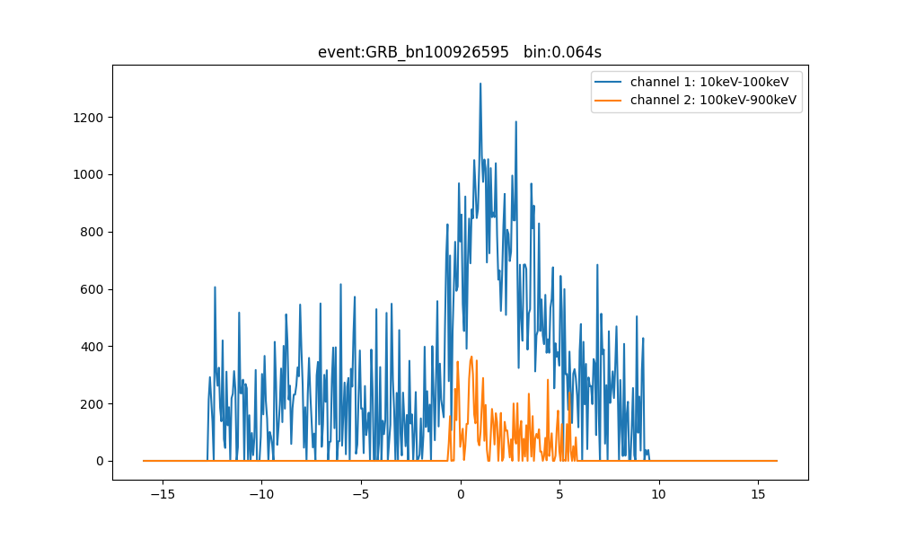

Slide 63
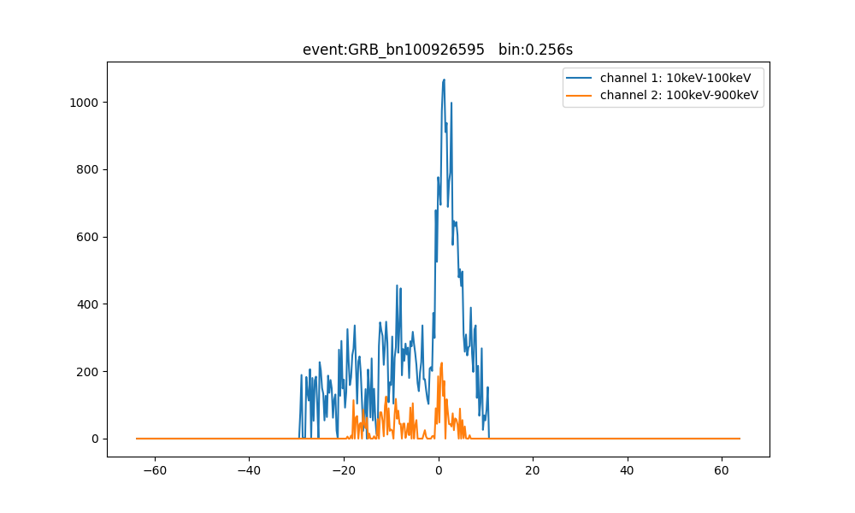

Slide 64


Slide 65
Event Analysis: GRB_bn110407998
[0.2259269 0.00304199 0.00338863 0.76764244]

Slide 66


Slide 67


Slide 68


Slide 69


Slide 70


Slide 71
Event Analysis: GRB_bn110825265
[0.07668504 0.00296331 0.00220439 0.9181472 ]

Slide 72


Slide 73


Slide 74


Slide 75
Event Analysis: GRB_bn110901230
[0.29899463 0.00466719 0.00506498 0.6912732 ]

Slide 76


Slide 77


Slide 78


Slide 79


Slide 80
Event Analysis: GRB_bn111018785
[0.04877729 0.00208264 0.00167519 0.94746494]

Slide 81


Slide 82


Slide 83


Slide 84


Slide 85
Event Analysis: GRB_bn130707505
[9.2236011e-04 4.2328108e-04 2.7087520e-04 9.9838352e-01]

Slide 86


Slide 87


Slide 88


Slide 89
Event Analysis: GRB_bn131212814
[0.0639547 0.02108183 0.00640189 0.90856165]

Slide 90


Slide 91


Slide 92


Slide 93


Slide 94
Event Analysis: GRB_bn211023546
[0.4131541 0.12347693 0.03608047 0.4272885 ]

Slide 95


Slide 96


Slide 97


Slide 98
Event Analysis: GRB_bn230225460
[0.48551232 0.00579307 0.00811478 0.5005798 ]

Slide 99


Slide 100


Slide 101


Slide 102


Slide 103


Slide 104
Event Analysis: GRB_bn231001015
[2.4772285e-02 1.0871622e-03 8.1022829e-04 9.7333026e-01]

Slide 105


Slide 106


Slide 107


Slide 108


Slide 109


